Slide 1


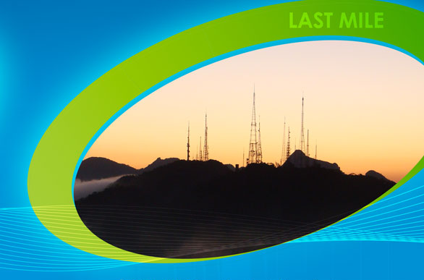
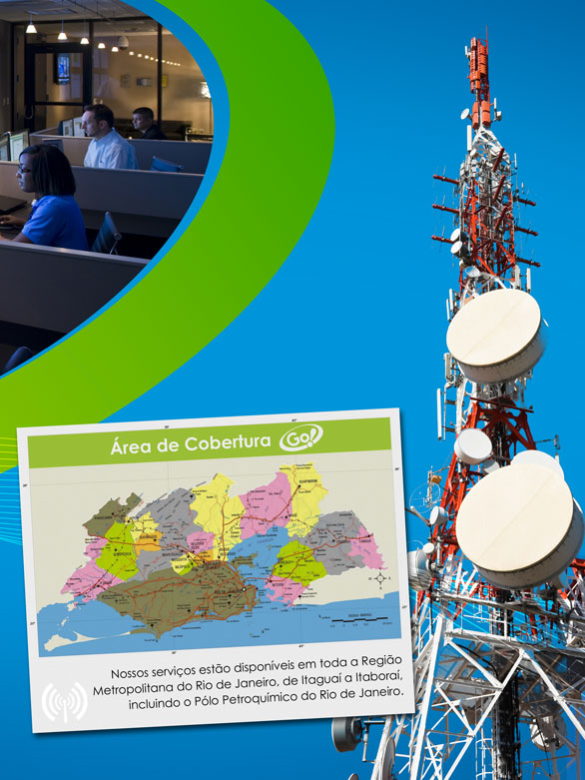
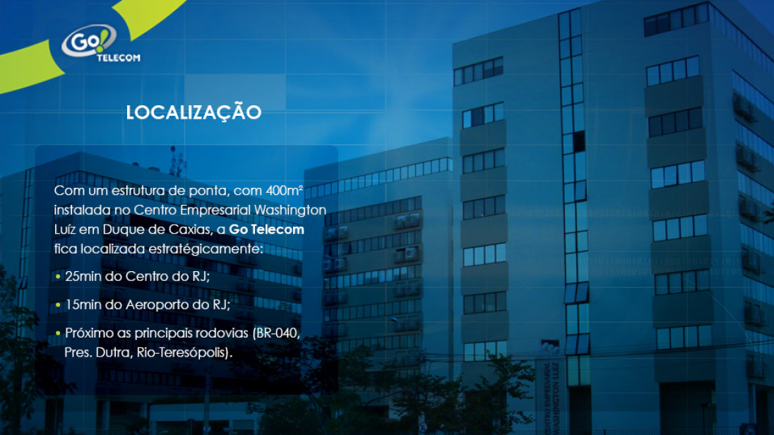
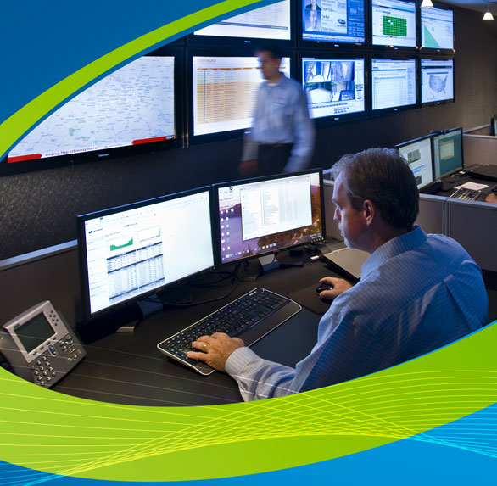
Go! TELECOM
Underwater Visible Light Communications (UVLC) & LED Transmissions
28 de novembro de 2014

Slide 2
Go! TELECOM
Underwater Visible Light Communications (UVLC) & LED Transmissions
Wi-Fi
Microwave
Fiber Optic
LED
Customers
Backbone
2015

Slide 3
Go! TELECOM
Underwater Visible Light Communications (UVLC) & LED Transmissions
2007 - Started independent R&D of VLC Technologies
2009 - Awarded an Entrust Business of Local Innovation R&D in 2009 of Ministry of Economy, Trade and Industry (Founded Okinawa UVLC Consortium (OUVLC))
2010 - Demostrated UVLC device at APEC（8th TELMIN：Ministerial Meeting on Telecommunications and Information Industry)
2011 - Founded Marine Comms Ryukyu, Inc. based on the organization of OUVLC

Slide 4
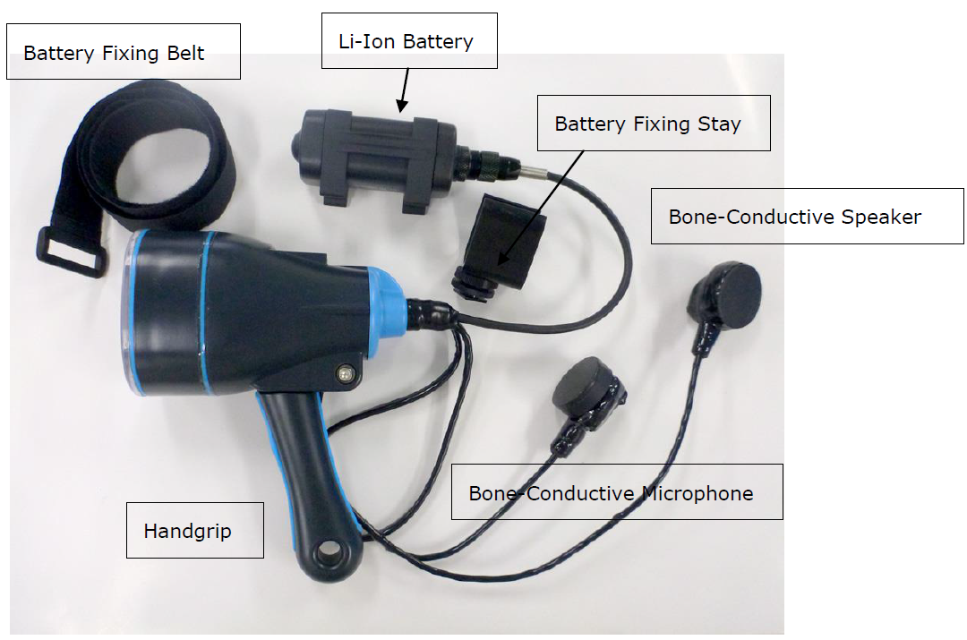
Go! TELECOM
Underwater Visible Light Communications (UVLC) & LED Transmissions

Slide 5
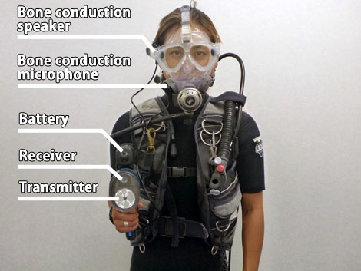
Go! TELECOM
Underwater Visible Light Communications (UVLC) & LED Transmissions
An Underwater speech device utilizing the visible light of LED

Slide 6
Go! TELECOM
Underwater Visible Light Communications (UVLC) & LED Transmissions
＜Specifications＞
- Maximum communication distance: 30m
- Maximum depth: 150m
- Lamp Type: 3W super high intensity white LED x9
- Light Output: 1,500 lumen maximum
- Communication channel: 2ch
- Battery Run Time: About 240 minutes
- Battery Charge Time: Max. 4 hours
- Applicable Voltage: 100 - 240V
- Spectrum: 380nm ~ 780nm

Slide 7
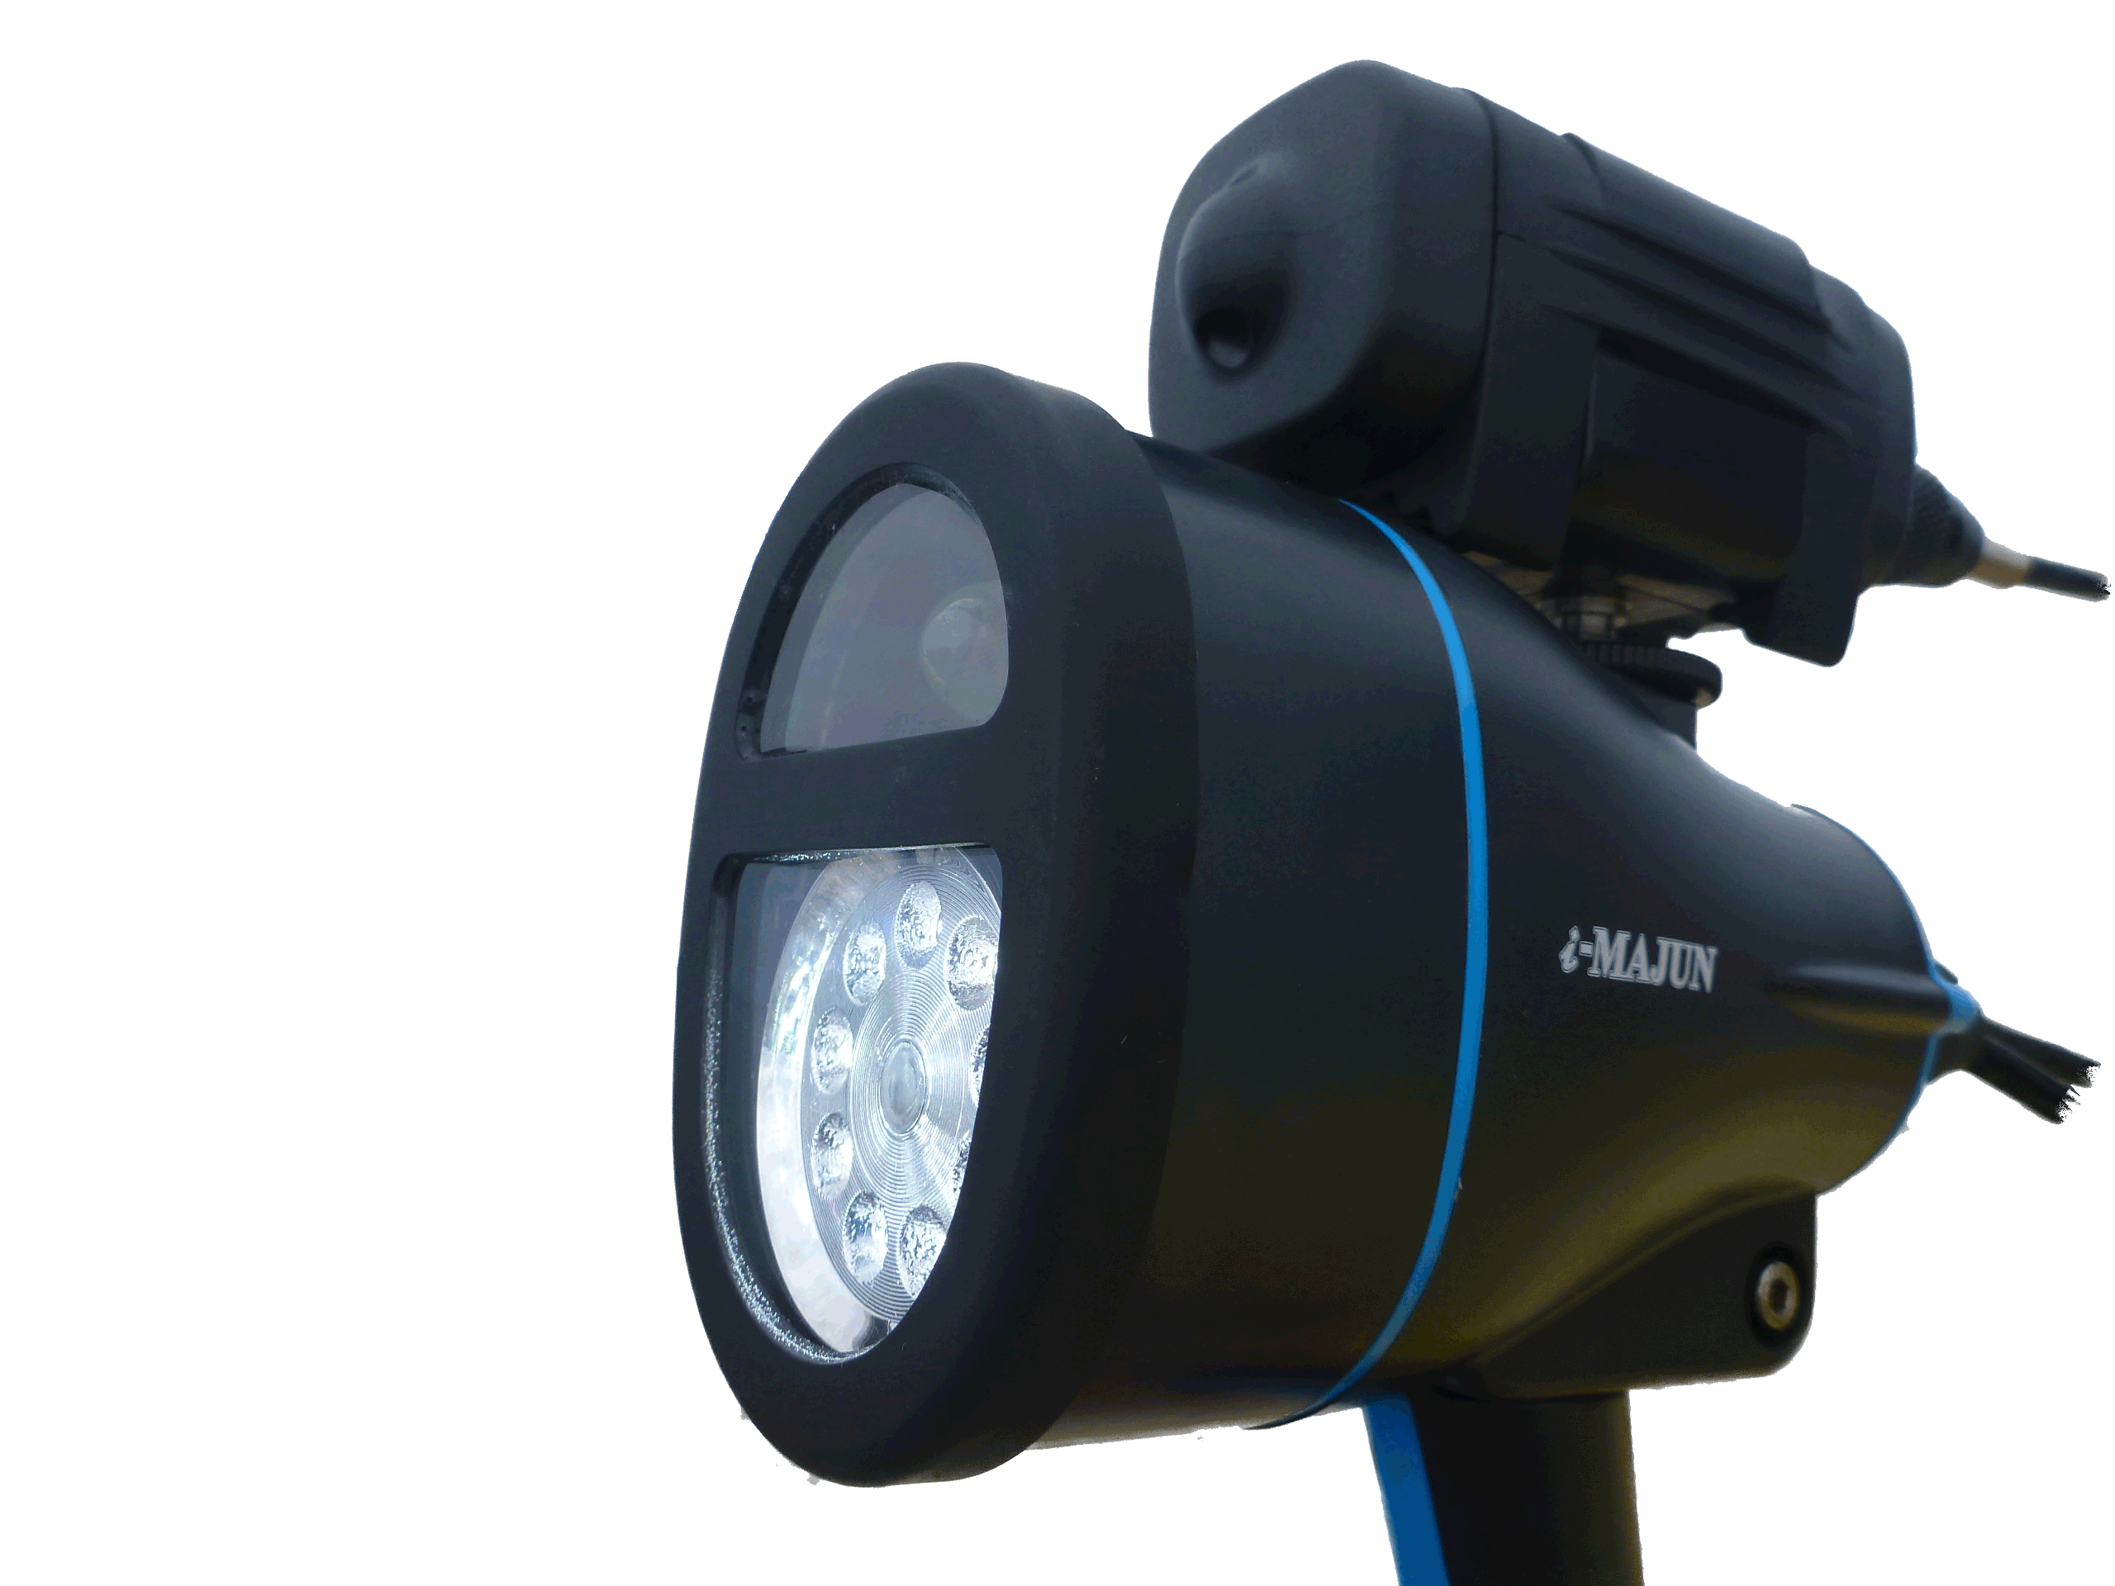
Go! TELECOM
Underwater Visible Light Communications (UVLC) & LED Transmissions
An Underwater speech device utilizing the visible light of LED
Catch the signal at the receiving part and produce the voice
from the buddy on the speaker
Modulating the voice signal on the light of white LED
Luminous Intensity of 1500 Lumen
Communications Distance around 30m
Duration around 4 hours

Slide 8
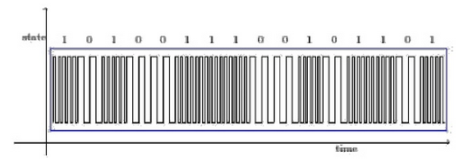
Go! TELECOM
Underwater Visible Light Communications (UVLC) & LED Transmissions
An Underwater speech device utilizing the visible light of LED
Example for binary frequency-shift keying.

Slide 9
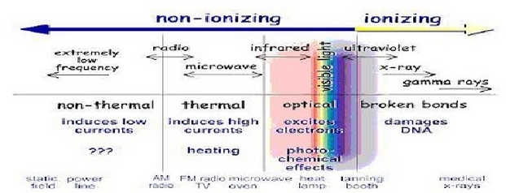
Go! TELECOM
Underwater Visible Light Communications (UVLC) & LED Transmissions
An Underwater speech device utilizing the visible light of LED

Slide 10
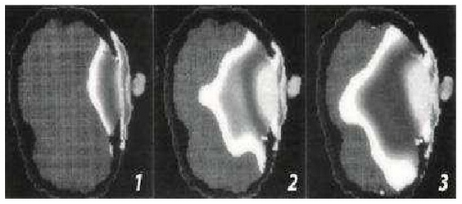
Go! TELECOM
Underwater Visible Light Communications (UVLC) & LED Transmissions
An Underwater speech device utilizing the visible light of LED
Electromagnetic field penetration in an adult, adolescent and a child respectively.
Using visible light for data transmission entails many advantages and eliminates most drawbacksof transmission via electromagnetic waves outside the visible spectrum.

Slide 11
Go! TELECOM
Underwater Visible Light Communications (UVLC) & LED Transmissions
Information exchange is possible between the ship and the divers or among divers without repeating the ups and downs in the water.

Slide 12
Go! TELECOM
Underwater Visible Light Communications (UVLC) & LED Transmissions
Lessen the effect from the downwash.
（Need some improvement on the mass products.)

Slide 13
Go! TELECOM
Underwater Visible Light Communications (UVLC) & LED Transmissions
Makes it possible to communicate without interception.
* Megaphone type (to be developed) will realize a 200m distance talk even on the rolling/pitching ships.
Flag signaling can be read with binoculars, though, even a high speed camera cannot read the signal of VLC.
Cost guard

Slide 14
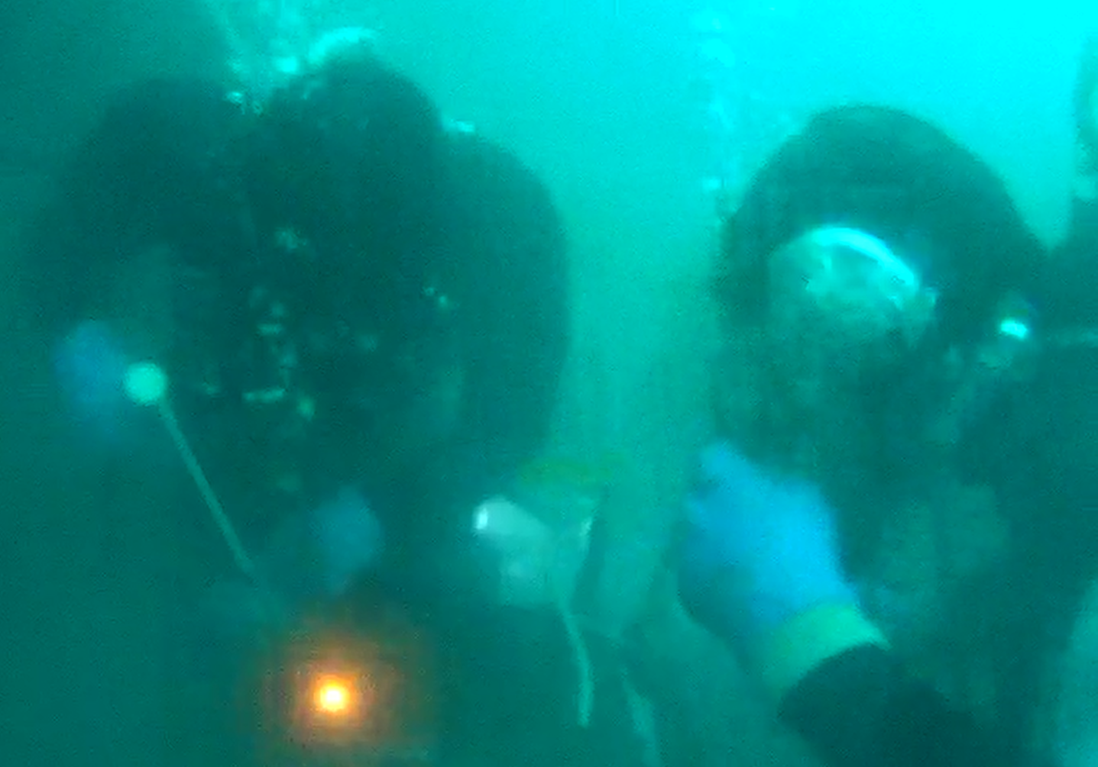
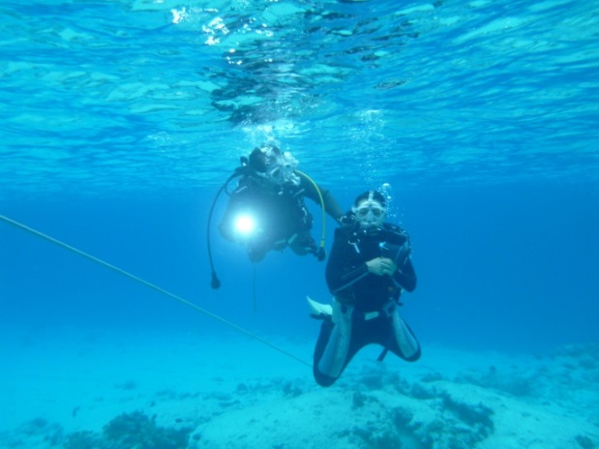
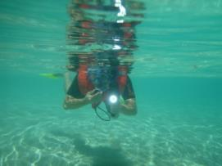
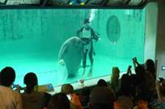
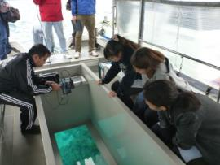
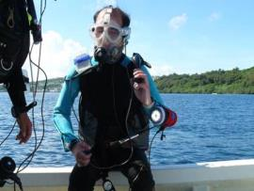
Go! TELECOM
Underwater Visible Light Communications (UVLC) & LED Transmissions
Maritime Construction
Leisure / Training
Snorkeling
Aquarium
Glass-bottom boat
Visually impaired

Slide 15
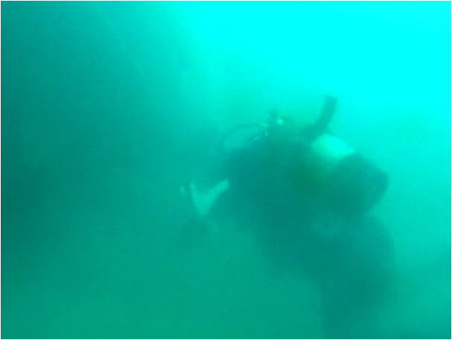
Go! TELECOM
Underwater Visible Light Communications (UVLC) & LED Transmissions

