Slide 1
eLoran and eDLoran
Mauro Vieira de Lima
Novembro 2014

Slide 2
GPS
Desvantagens
GPS é um sistema de posicionamento, navegação e tempo (PTN) controlado por militares americanos com possibilidade de introdução de ruído por razões militares.
Serviço espacial que pode sofrer queda por ejeções de massa coronal (CME) do sol.
Sem recepção dentro de construções.
No Brasil, fenômeno da cintilação ionosférica causa perda de sinal.
Alto custo de implementação 1 satélite ≈ US 100 milhões (24 satélites)
Nações desenvolvidas buscam backup sem as vulnerabilidades do sistema espacial.

Slide 3
eLoran
Enhanced Loran is an internationally-standardized positioning, navigation, and timing (PNT) service for use by many modes of transport and in other applications.
It is the latest in the long-standing and proven series of low-frequency, LOng-RAnge Navigation (LORAN) systems
eLoran meets the accuracy, availability, integrity, and continuity performance requirements for aviation approaches, maritime harbor entrance and approach maneuvers, land-mobile vehicle navigation, location-based services and a precise source of time and frequency for applications such as telecommunications.
eLoran is an independent, dissimilar, complement to Global Navigation Satellite Systems (GNSS). It allows GNSS users to retain the safety, security, and economic benefits of GNSS, even when their satellite services are disrupted.

Slide 4
eLoran
eLoran is a terrestrial low-frequency (100 kHz) system organized as chains, each consisting of a master station with two or more secondary stations.
Each station broadcasts in a strict time format series of 8 or 9 pulses of approximately 250 µs.
The effective radiated power is in the range of 100 to 1,000 kW, depending on the required working range. These high powers are required by the high levels of atmospheric noise in the 100 kHz frequency band.
Radiating such high-power pulses requires large vertical transmitting antenna of about 200 meters height.

Slide 5
eLoran
Error Sources
The total position error of Loran depends on the accuracy in time of the high-power generated Loran pulses feeding the antenna, the stability of the physical phase center of the Loran transmitter antenna, stability of the tuning of the antenna circuit, the accuracy of the measured additional secondary phase factor stored in the Additional Secondary Factor (ASF) database, and the quality of the Loran receiver.
ASF is the additional delay when Loran signals propagate over land with a varying conductivity.
ASF Data. The net travel time of the Loran signal from the transmitter to the receiver antenna is the sum of the propagation through the atmosphere (primary factor or PF), some extra delay due to traveling over seawater (secondary factor or SF), and finally ASF. The PF and SF are calculated from models, while the ASF must be measured.

Slide 6
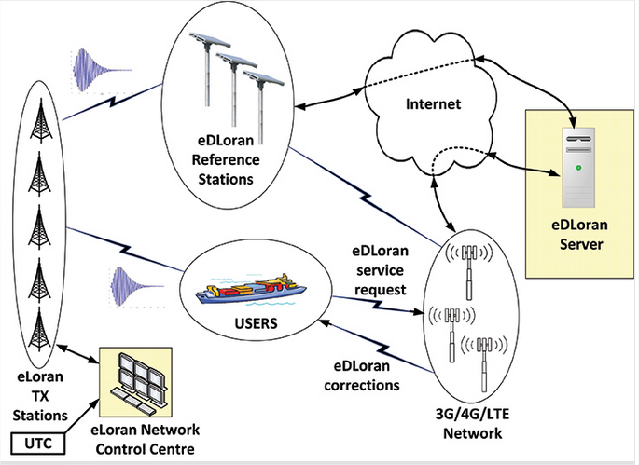
eDLoran
Enhanced Differential Loran
technique strongly resembles the technique of Differential GPS where the correction data are sent through LF-radio beacon stations to the user receiver.

Slide 7
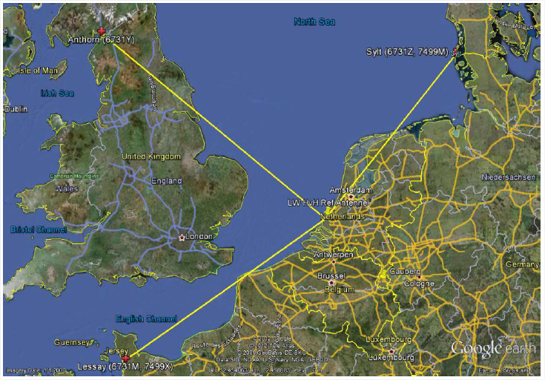
eDLoran
The Loran configuration in the test area of Europort in Figure shows the test area of enhanced Differential Loran (eDLoran). The Loran stations of Lessay (France), Sylt (Germany) and of Anthorn (UK) were throughout used

Slide 8
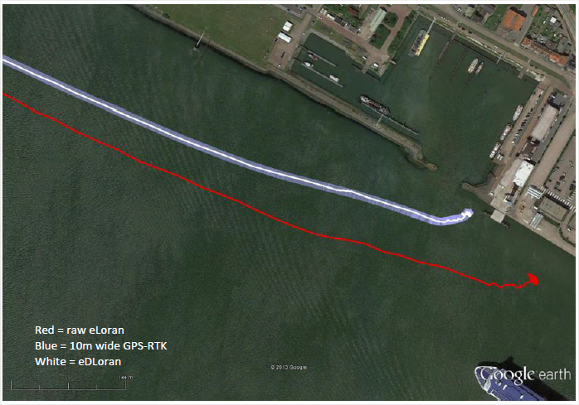
eDLoran
The red track is based on raw eLoran data without any corrections. The transparent blue line is made by GPS-RTK and is widened to 10 metres giving the required ± 5 metre limits of eDLoran. The white line is output from the eDLoran receiver which stays within the borders of the 10 metre wide transparent blue line

Slide 9
Obrigado
Mauro Lima

